Slide 1
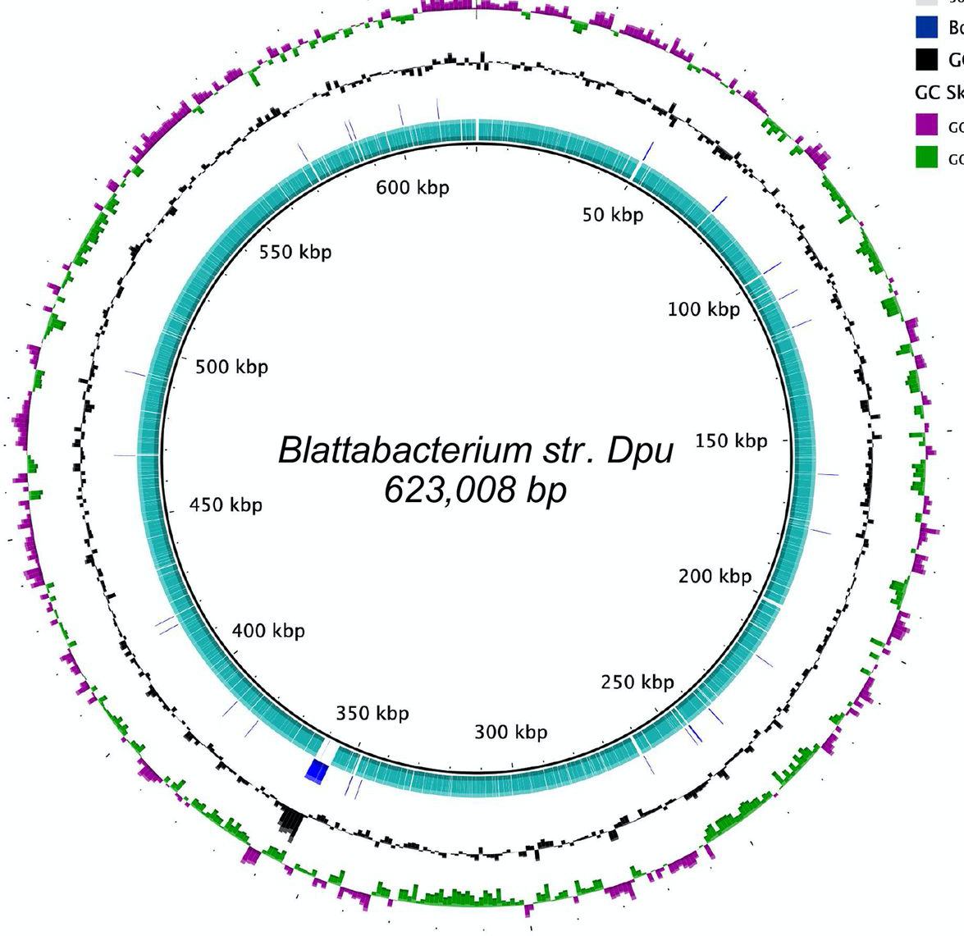
This is just a cartoon style
figure for a talk I gave at ento
conference but could be made
into a proper figure with more
detail. The coloured lines inside
the circle could be given proper
numbers from an actual genome
based on one of the BLAST
chimera diagrams
host DNA
chimeric insert
host DNA

